Slide 1
Git training
January, 2016

Slide 2
Agenda
Presentation
Installation
Getting started
Git Concepts and Architecture
Branching
Merging

Slide 3
Presentation
1

Slide 4

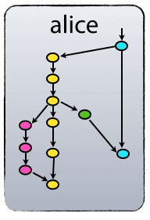
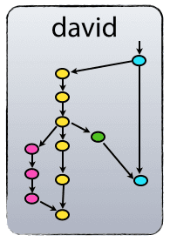

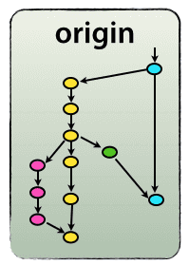

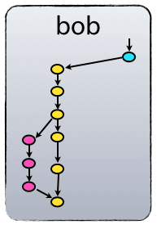


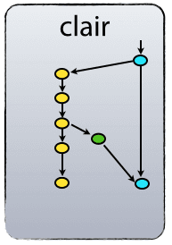
What is git
git is a decentralized versioning code system (DVCS), it does not require a server to run.
A remote repository still exists for sharing purposes, but it is not mandatory
This repository is called origin

Slide 5
Installation
2

Slide 6

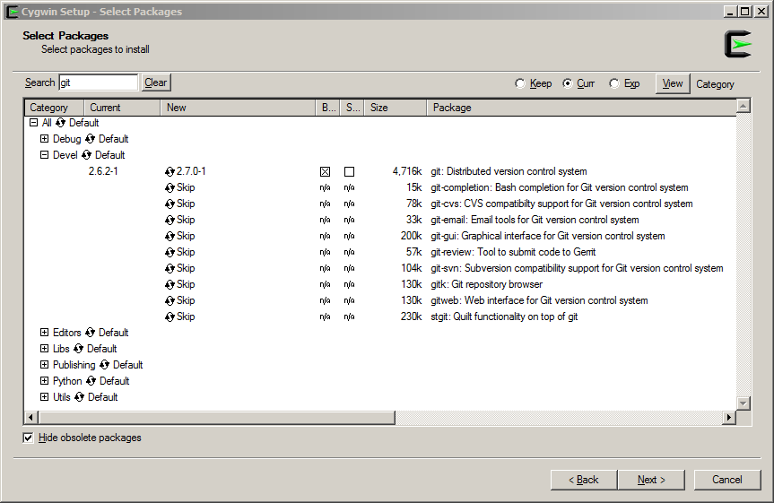
Installation
Long Topic Text 1 | Long Topic Text 2 | Long Topic Text 3 | Long Topic Text 4 | Long Topic Text 5 | Long Topic Text 6
Using Cygwin
https://www.cygwin.com/

Slide 7
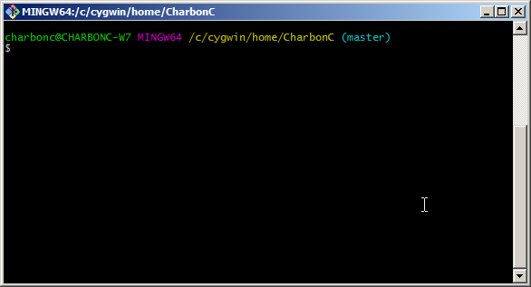
Installation
Long Topic Text 1 | Long Topic Text 2 | Long Topic Text 3 | Long Topic Text 4 | Long Topic Text 5 | Long Topic Text 6
Using the Windows flavored version
https://git-scm.com/downloads

Slide 8




Git setup
Configuration
Git has 3 levels of configuration
--system
System-wide - apply to all users on the computer
--global
User-wide - apply to the current user
--local
Repository-wide - apply to the current repository

Slide 9
Git setup
Configuration
Minimum configuration
$ git config --global user.name <Username>
$ git config --global user.email <firstname.lastname>@pingan.com.cn
$ git config --global autocrlf = true
When working with Windows environment, auto-converting CRLF line endings into LF when you add a file to the index and vice versa when it checks out code onto your filesystem
https://git-scm.com/book/en/v2/Customizing-Git-Git-Configuration

Slide 10
Getting started
3

Slide 11


Getting started
Initializing a local repository
$ git init
Very 1st git workflow
$ echo ‘This is a sample file’ >> file.txt
$ git add file.txt
$ git commit -m “Add file.txt”
$ echo ‘new line’ >> file.txt
$ git diff
$ git add file.txt
$ git commit -m ‘Append new line’
$ git checkout HEAD^
$ cat file.txt
Append new line
HEAD
Add file.txt

Slide 12

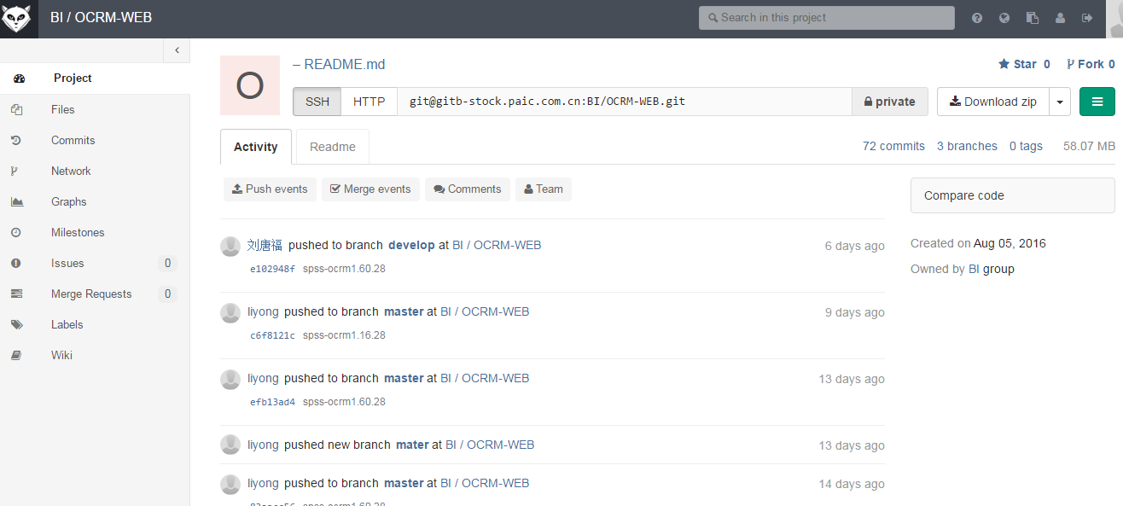

Getting started
Cloning an existing repository
$ git clone <repo-url>
To get the repo-url
http://ersgit/projects/RDF/repos/conf-dev/browse

Slide 13
Getting started
SSH configuration
If you’re not identified, you’ll only get the http-url
unsecure
heavy
read-only access
It is not recommended
ssh connection is greatly preferred

Slide 14

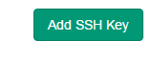
Getting started
SSH configuration
To configure SSH connection:
generate a public key for your user@machine
$ ssh-keygen
add the key in stash
Paste generated key
~/.ssh/id_rsa.pub

Slide 15

Getting started
SSH configuration
Once you’re identified, you’ll get the ssh-url
Then you can clone:
$ git clone git@gitb-stock.paic.com.cn:BI/ocrm-service.git

Slide 16

Getting started
Inside the git directory
Git stores all its data/informations in one directory
.git
Only one .git directory at the top level to stores it all (no .svn in each single directory)

Slide 17
Git concepts and architecture
4

Slide 18

The 3-trees architecture
Unlike other SCMs which uses a 2-trees architecture (working-copy + remote-tree), git uses a local 3-trees architectures:
WORKSPACE
INDEX
LOCAL REPOSITORY
git add
git commit
working copy
staging-index
local-repository
Adding a file to the repository is a 2-step process:
add (add to the staging index)
commit (save to the repository)
http://ndpsoftware.com/git-cheatsheet.html

Slide 19

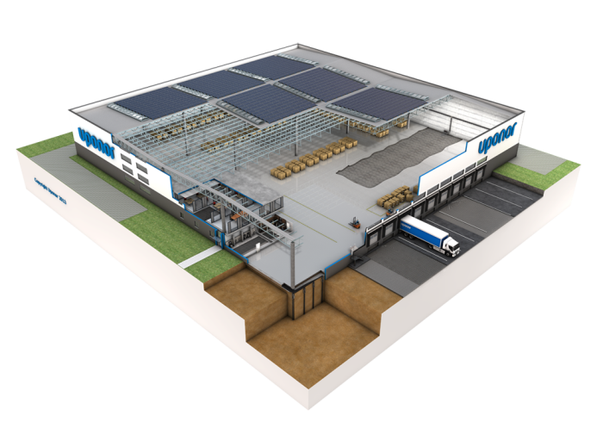


The 3-trees architecture
A metaphor
WORKSPACE
INDEX
LOCAL REPOSITORY
REMOTE REPOSITORY
git add
git commit
git push
git reset
git checkout
git fetch
git clone/pull

Slide 20

Commits
What is a commit
In git, there is no file version
git uses commits
commits refers to history of the repository
commit
id | 7094b4795fea4b76c23d311d6d150361470de3dd
parent | 1ec1476f263b6f71422bb0a9eba1f87fb2351f19
author | John Doe
date | 2016/01/01 08:45:07
message | This is the description
file-set change
commit-id is a checksum (SHA-1) of the changeset
changeSet
a commit represents a set of changes
It is not related to 1 particular file or file version

Slide 21
Commits
Viewing history
In the git world, a history is usually seen as this:
$ git log
29844f5ed3577293e79b2d269040bd281b8766ea
7760894542fb7ac322f787eb207101027d086407
c640b696db71e5d4021f44594af6f5c30c691ba9

Slide 22



Organize a commit
Handle the staging-index
WORKSPACE
INDEX
To unstage a file:
$ git reset <paths>
You may want to do this when you are trying to assemble a commit.
For instance, if you did:
$ git add *
And you want to split your changes in several commits:
$ git reset *.scala
$ git commit –m ‘Java files’
$ git add *.scala
$ git commit –m ‘Scala files’
Scala files
Java files

Slide 23

HEAD pointer
HEAD is a reference variable
HEAD is the parent of the next commit (playhead)
$ git commit …
$ git commit …
$ git checkout HEAD^^
$ git commit …
HEAD

Slide 24
Retrieve a specific version
Repository to working-directory
$ git checkout <commit>
Equivalent to perforce « rollback to revision »
HEAD

Slide 25

Undoing
Reset working-directory AND staging-index
$ git reset --hard
the staging-index is modified so it matches what HEAD is now pointing to
the working-directory is modified so it matches what HEAD is now pointing to
WORKSPACE
INDEX
LOCAL REPOSITORY

Slide 26

Understanding the diff command
WORKSPACE
INDEX
LOCAL REPOSITORY
$ git diff
gives difference between
working-copy and staging-index
$ git diff --staged
gives difference between
staging-index and local-repository
$ git diff HEAD
gives difference between working-copy and local-repository

Slide 27
Branching
5

Slide 28

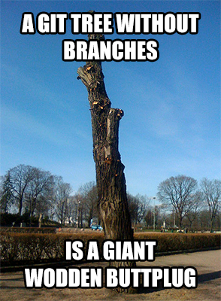
Branching
Branching

Slide 29
Branching
Definition
A branch is a pointer to the latest commit in a “line of work”.
A branch is moving as commits are submitted.
Branches are light, cheap and quick and easy to manage.

Slide 30
Branching
Creating and switching branches
Create
$ git branch <branch>
Switch
$ git checkout <branch>
Create and switch
$ git checkout –b <branch>
Delete local
$ git branch –d <branch>
develop
feature

Slide 31
Branching
Working with branches
Making some changes on featureA branch
$ git checkout featureA
$ git commit …
Making some changes on featureB branch
$ git checkout featureB
$ git commit …
Making some changes on featureA branch
$ git checkout featureA
$ git commit …
featureB
HEAD
featureA

Slide 32
Merging
6

Slide 33

Merging
Merge types
In the git world, merging is:
create a new commit potentially
moves the HEAD pointer
There are 2 type of merges:
fast-forward merges
no new commit is created
only branches are updated
‘real’ merges

Slide 34
Merging
Fast-forward merge
Merging the feature-branch onto develop
develop
feature
branch
Switch back to ‘develop’
$ git checkout develop
Merge the ‘myfeature’ branch onto current branch
$ git merge myfeature
Delete ‘myfeature’ branch
$ git branch –d myfeature
HEAD

Slide 35
Merging
“no-ff” merge (preferred)
A real merge creates a new commit.
develop
feature
branch
Switch back to ‘develop’
$ git checkout develop
Merge the ‘myfeature’ branch onto current branch
$ git merge --no-ff myfeature
Delete ‘myfeature’ branch
$ git branch –d myfeature
HEAD

Slide 36

Merging
Fast-forward merge vs “no-ff” merge
develop
develop
feature
feature
$ git merge
(plain)
$ git merge --no-ff

Slide 37
Merging
Finalizing a merge
Merge can possibly « fail » and leave uncommited changes
resolve conflicts with you favorite tool (IntelliJ, BeyondCompare, etc…)
then commit

Slide 38



Push / Pull
Resolving conflict workflow
WORKSPACE
INDEX
LOCAL REPOSITORY
REMOTE REPOSITORY
git push
git pull
git merge / commit
git push

Slide 39

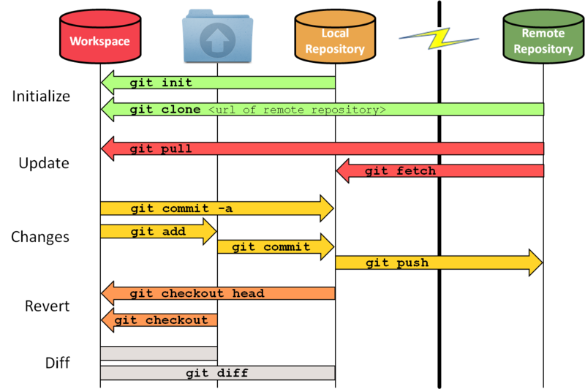
Overall workflow

Slide 40
Git advanced use
7

Slide 41
Getting started
Viewing the commit log
$ git log
Main git log interesting options
--oneline | Short SHA-1 + message
--decorate | Shows branches, tags
--graph | Display as graph
--all | All the branches (default is HEAD)
Other git log worth mentioning options
-<number> | Shows only the <n> latests
--since|until | Date filter (« 2016/01/01 », yesterday, n days)
--author | Author filter
--grep | Message filter

Slide 42

Resetting
Presentation
git reset is used to:
specify where the HEAD pointer should point to
modify (undo changes in) the staging-index
modify (undo changes in) the working-directory
IMPORTANT:
it should only be used to undo local changes.

Slide 43
Resetting
In detail
What can be done with git reset :
HEAD is moved
the staging-index is modified so it matches what HEAD is now pointing to
the working-directory is modified so it matches what HEAD is now pointing to
git reset modes:
soft
mixed (default)
hard

Slide 44
Resetting
Soft
$ git reset --soft <commit>
HEAD
HEAD is moved
the staging-index is modified so it matches what HEAD is now pointing to
the working-directory is modified so it matches what HEAD is now pointing to
Practical use cases:
you commited to the wrong branch
Notes:
You want to combine a series of commits:
git commit -m “1“
git commit -m “2“
git commit -m “3“
git log --oneline --graph --decorate
git reset --soft HEAD^^
git commit -m “123“
git log --oneline --graph --decorate

Slide 45
Resetting
Mixed (default)
$ git reset --mixed <commit>
HEAD is moved
the staging-index is modified so it matches what HEAD is now pointing to
the working-directory is modified so it matches what HEAD is now pointing to

Slide 46
Resetting
Hard
$ git reset --hard <commit>
HEAD is moved
the staging-index is modified so it matches what HEAD is now pointing to
the working-directory is modified so it matches what HEAD is now pointing to
Practical use cases:
completely discard all of the changes made between the old and new HEAD location
Equivalent to « rollback to revision » in perforce

Slide 47
Resetting
Soft, mixed, hard
--mixed and --soft are both safe operations (they will not overwrite the contents of your working directory)
--hard is destructive (ie dangerous)

Slide 48
Resetting
Another reset usage
$ git reset -- <paths>...
HEAD is moved
the staging-index is modified so it matches what HEAD is now pointing to
the working-directory is modified so it matches what HEAD is now pointing to
This actually makes plain sense, because if the first step is to move a pointer to a different commit and you can't make it point to part of the commit, so it simply doesn't do that part.

Slide 49
Resetting
Comparison with checkout
git checkout <branch> is pretty similar to git reset --hard <branch> (updates all 3-trees), but there are two important differences:
checkout is safer (won’t overwrite modifications in working directory if any)
checkout moves HEAD and leaves the branch, reset moves branch HEAD points to
Note: this talks about branches that we did not talk yet

Slide 50
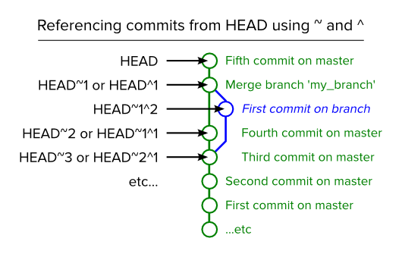
Commit referencing

Slide 51
Git教程--https://git-scm.com/book
常用命令--http://www.ruanyifeng.com/blog/2015/12/git-cheat-sheet.html

